Slide 1
ODD scenarios and thoughts
Laurent Romary
INRIA Gemo & Humboldt Univ. IDSL

Slide 2
Why should we make ODD develop?
Initial design
  Providing the TEI with its own specification language
    Nearly intended for internal use only
Evolution
  Wider usage within the TEI community
    ODD has become the customization language for many TEI based application
  Usage outside the TEI community
    ODD is being used for non TEI based applications
      E.g. W3C/ITS, ISO/TC 37/SC 4

Slide 3
Quick technical history
First design concepts (Paris, March 2004)
  Modules, classes, @mode=add/change/delete
Stabilizing concepts (Gent, 13-15 May 2004)
  Durand conundrum
    To be or not to be RelaxNg: the ODD abstract layer is felt necessary
    Roma, SF
    A shared understanding of customization
Since 2004, continuous changes on the documentation elements
  E.g. describing content (other schema languages, valList)
But things have remained very stable

Slide 4
But for whom are we doing this?
A thought experiment: imagining our users
  Basic user scenarios
  Usage context
  Basic needs
  Consequences for management, editorial or technological requirements
Well, not pure imagination, though

Slide 5
S1: digitization project
Christiane wants to document the TEI subset used for a big digitization project at BBAW (DTA)
  Full conformance to TEI
  Reduced subset of elements to ensure a strong coherence
  Constraints on specific attribute values
  Heard of TEI Tite, would like to adapt
Christiane is obliged to start from scratch and hack the ODD version of Tite she got
  Relation with Tite is lost (shared documentation, synchronisation with future developments of Tite)

Slide 6
S2: SIG project
Kevin, Michelle and Syd want to document the TEI subsets corresponding to the TEI in libraries guidelines
  Full subsets of TEI + specific constraints
  Close connection with TEI Tite principles (level 3.5)
Kevin and Syd are obliged to design one schema for each level
  No re-use of content from one level to the other
  Impossible to design Tite as a variation of one of the schemas

Slide 7
S3: design of a new profile
Fotis, Elena and Malte want to design a new application profile for manuscript transcription
  They are TEI experts
  They have a large community of non technical experts who will not want to get into the details of the TEI and use an off the shelf customization
How to synchronize or compare with the TEI as a whole
  Design outside the TEI environment/namespace
  Re-use the global TEI document structure
  Re-use components here and there
    Specific constructs, maybe feature structures as an independent module
  Make the result transparent from heavy TEI technology
  Integrate a new proposal into the TEI framework in one step!

Slide 8
S4: Filius prodigus
W. has designed a series of schemas independently of the TEI for the encoding of scholarly papers
  Big institutional support and large community of users
  No real maintenance strategy and tools
  Would like to come back to a more TEI compliant structure while preserving backward compatibility
  Tradeoff
    Start making an ODD spec for his own schema
    Start defining a TEI subset matching the features of his schema
No way of offering him a step by step approach
  Add TEI components step by step
  Provide and maintain parallel mechanisms

Slide 9
S5: ISO project
Eric wants to use ODD to edit his ISO project 24611
  Standard for the Morphosyntactic annotation of texts
  He has hardly ever seen a teiHeader in his life
  Has been convinced that ODD is cool (has read Knuth)
  I forgot: he cannot live without feature structures
A license to diverge
  If he stays within the TEI framework, he has to import all basic components and is not allowed to redefine some elements (<seg>)
  If he designs his schema from scratch, not allowed to reuse even basic components (@target)
The coherence with the TEI is lost…
  Although it would be cool to have MAF as a TEI module

Slide 10
Various documentation scenarios
I want to use the TEI stylesheets but add my own layout
I want my documentation to contain only the changes I have made to the TEI elements
I want the schema documentation to appear in a separate output
I want the RelaxNG scheme to appear as appendix to my documentation

Slide 11
Families of schemas
A central notion for the future of the TEI
  Intermediate schemas used for deriving several specific ones
  Subsumption properties (“subset”)
Maintenance
  Within or outside the TEI consortium
    Reference schemas (Tite), project specific schemas
  Document, register, disseminate, re-use

Slide 12
TEI in libraries: a family of models
Scholarly Encoding
semantic, linguistic, prosodic elements
Level 5
Basic Content Analysis
sic;corr; listName
Level 4
TEI Tite
Simple Analysis
p; lg; list; table; figure
Level 3
DTA variant
Europeana variant
Minimal Encoding
div;head
Level 2
Constraint x
Constraint y
Constraint z
Fully Automated Conversion and Encoding
Level 1

Slide 13
Thinking this out
What we need
  A general mechanism to deal with inheritance
  Coherence with (some of) the current TEI architecture principles
  Thinking of a transition plan
    Remember: we don’t have the budget for a revolution…
  Taking the opportunity to introduce some cool mechanisms
    If we happen to think of some of them
And no, I don’t have all answers (disappointed?)

Slide 14
Odd specification inheritance
Step 1: autonomous ODD specifications/modules
  No “Master ODD”
RelaxNG, DTD, W3C
ODD spec1
(<schemaSPec>
<moduleSpec>)
ODD spec2
(<schemaSPec>
<moduleSpec>)
Flat ODD
RelaxNG, DTD, W3C
ODD spec3
(<schemaSPec>, add, del, change)
Flat ODD

Slide 15
Module independence and inter-dependence
Modules should not require implicit presence of other modules
  Note: importance in the case of versioning
Explicit reference to modules whose content is necessary for the definition of another module
  E.g. global attributes
Modules are identified uniquely and persistently (PID)
  cut the umbilical cord…
Probably as much work as when we started cleaning up classes ☹

Slide 16
Consequences
External references in ODD
  Chaining schemas
    <schemaSpec source="http://myStableURI.org/myFavouriteodd"/>
    The whole base specification is taken up as the source for the new schema
  Chaining modules
    <moduleRef key="core" source="http://myStableURI.org/myFavouriteODDSPec.odd"/>
    A given version of the module is used here, within or without the TEI framework

Slide 17
Odd specification inheritance
Step 2: pointing to the things you need
  Rather than delete the things you don’t want (and don’t know about)
    <elementSpec ident=”huglyThing" mode=”delete">
  But selecting elements one by one can be tedious
    <elementSpec ident=”sexyThing" mode=”use”>???
  We need an intermediate granularity level
    <cristalSpec ident=“biblStruct” mode=“use”>
      Brings in <biblStruc> and the necessary sub-components to make it useful (analytic, monogr, series, imprint, title, author, etc.)

Slide 18
A central concept: crystals
Definition: independent group of connected elements (clique) with semantic coherence
  Crystals can be of any size, from single element up to complex combination thereof
  Crystals can be combined to form bigger crystals
e.g. [Print dictionary]
  <gen>
  <gramGrp>
    model.gramPart (minimally populated)
  <entry>
    and subsequent content
<entry>
<gramGrp>
<gen>

Slide 19
Crystals and modules
Modules are designed as groups of crystals
  Cf. module independence
Modules can share crystals through inclusion of same component modules
  Cf. module inter-dependency

Slide 20
Odd specification inheritance
Step 3: morphism in the TEI
  Definition (Wikipedia): abstraction derived from structure-preserving mappings between two mathematical structures.
  For the TEI: thinking deeply how we re-use existing elements for further specifications
    “local customizations”

Slide 21
Equivalences – future of <equiv>
Is there an intrinsic syntactic/semantic difference between:
<span type=“communicationFunction”>
@mode=change
<span>
and:
<communicationSegment>
@equiv
<span type=“communicationFunction”>

Slide 22
<equiv>: making it more procedural
So far, purely declarative
  At best: providing a stylesheet to transform new element to old one
  Keeping this to connect to external ontologies: ISO/DCR, CRM
Doing further
  Introducing @mode for <equiv>
  Inherit all properties (content, classes, attributes) from the source element depending on @mode constraints
Introducing @mode for <equiv>
  @mode=change; replaces the existing element
  @mode=add; comes in complement to the existing element

Slide 23
The TEI ecology
ISO DCR
CRM
W3C module
ISO module
TEI module 1
TEI module 2
e.g.: XLink
ODD spec 1
ODD spec 2
<moduleRef url=“w3c.org/Xlink.odd”/>

Slide 24
Conclusion?
… so many issues remain to be explored
  I also wanted to speak of:
            Subsumption
              Classes: intensional definition, extensional set of members; how to express this?
            Bundles: variant of an element with further refinement ; in particular local metadata
              xxxGrp, xxxStmt
            Flat/full ODD vs. derivation ODD
To be continued…

Slide 25
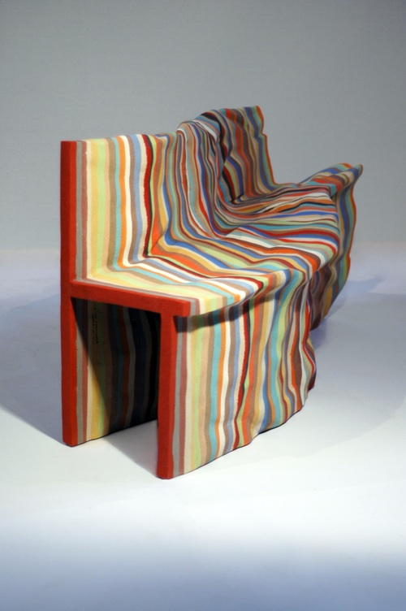
www.juliencarretero.com
<title>To be continued bench</title>
<author>Julien Carratero</author>
<quote>It deals with creating a real and recognizable uniqueness within serial production. Instead of leaving randomness manage the differences, it uses the repetitive actions existing within the production process as a tool for differentiation. Then each piece produced comes as a result of a process applied on the piece that came before. Each piece is then existing because of the others and couldn’t have been designed without the others. Each layer is casted on top of the one casted before following the exact outline of it. Because of the imperfection of the cast, the object slowly mutates and start designing itself.</quote>

